Slide 1
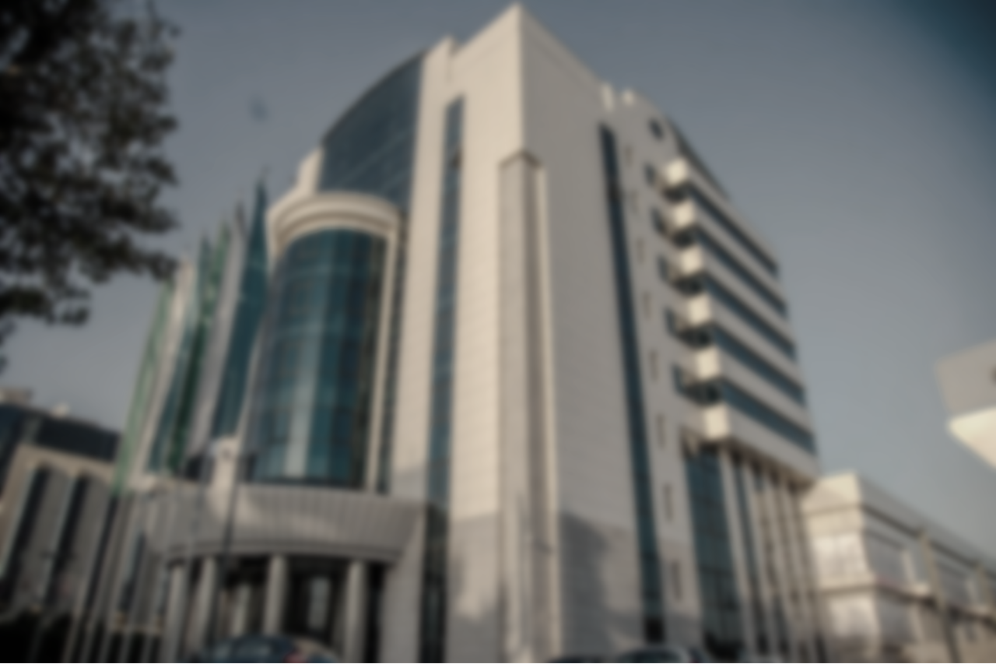
Islamic Finance: opportunities for leasing development in Uzbekistan
Mr. Botur Yusupov JV JSC “Uzbek Leasing International A.O.” and Leasing Association of Uzbekistan

Slide 2
Agenda
1
2
3
4
Traditional leasing vs. Islamic Ijarah
Uzbek Leasing International A.O.
Opportunities in Uzbekistan
Leasing market of Uzbekistan

Slide 3
Leasing market of Uzbekistan

Slide 4
Leasing Association of Uzbekistan since 2005
Since 2005
The mission of Leasing Association of Uzbekistan is :
to create the conditions for the development of leasing services in the Republic of Uzbekistan to ensure the effective implementation of economic reforms in the Republic
to conduct training and seminars
to represent of the legitimate interest of member of the Association
to collect and analyze information about the activities of the Association, as well as the activities of Members of the Association;
Leasing Association has 32 members (30 leasing companies and 2 banks)

Slide 5
Volume of new lease deals
Leasing portfolio
Since 2005
in bln. UZS
in bln. UZS

Slide 6
Leasing market structure by new leasing transactions in 1H-2021
Since 2005

Slide 7
Leasing market “players”
Since 2005
1H-2021
141 Lessors in leasing market
№ | Name of lessor | Share of new leasing transactions
1 | O’zagrolizing | 36,0%
2 | Uzbek Leasing International A.O. | 13,2%
3 | Fincom Leasing Group | 12,4%
4 | Kamaz Asia Leasing | 9,4%
5 | Nano Lizing | 9,1%
6 | O'zavtosanoat-Leasing | 4,1%
7 | CLG | 1,6%
8 | Asaka-Trans-Leasing | 1,6%
9 | Infin Leasing | 1,5%
10 | Taiba Leasing | 1,4%
90,3% of total market

Slide 8
Market oriented leasing companies
Since 2005
*without subsidized state-owned leasing companies (O’zagrolizing, O’zmeliomashlizing)

Slide 9
Leasing companies of Uzbekistan working with ICD
2008:
Murabaha facility from ICD – USD 1 mln
2014:
Murabaha facility from ICD – USD 5 mln
2017:
Murabaha facility from ICD – USD 7 mln
2021:
Murabaha facility from ICD – USD 10 mln (at the stage of approval)
Since 2005
2010:
Equity capital of ICD – USD 5 mln
2014:
Murabaha facility from ICD – USD 5 mln
2016:
Murabaha facility from ICD – USD 5 mln
2017:
Equity capital of ICD – USD 5,1 mln

Slide 10
Difference between Traditional leasing and Islamic Ijarah
 | Traditional Leasing in Uzbekistan | Islamic Ijarah
Ownership | The transferred asset does not belong to the bank | The leased object belongs to the bank
Ownership risks | The bank does not take responsibility for the loss of an asset | The bank is responsible for the loss of the object
Payment start date | Payments may be collected prior to delivery of the item. | It is forbidden to collect rent before the transfer of the object
Cancellation of a contract | The bank has the right to unilaterally terminate the agreement | Unilateral modification or cancellation is prohibited
Penalty | In case of late payment, fines are born and these payments are considered the bank's income | Fines may be levied for late payment and only for warning purposes. These payments are sent to charity
Capital construction costs | Borne by the tenant | Borne by the owner
Property sale | The lease and the purchase agreement are merged | It is forbidden to combine two contracts

Slide 11
International Leasing Company
www.uzbekleasing.uz

Slide 12
Shareholders
NBU
Maybank
(Malaysia)
Since 1995
41,56%
19,70%
38,74%
Uzbek-Oman
Investment
Company
Note: EBRD and IFC were shareholders from 1995 to 2012.
In 2012 UzOman purchased shares of EBRD and IFC

Slide 13
JSC JV “Uzbek Leasing International A.O.”
Since 1995
Date of establishment – 1995
Lease transactions – over 2000
Total value of leasing deals – over USD 250 mln.
Acceptable objects of lease – various types of production equipment, construction equipment, trucks, real estate, etc.
Main customers – private SME’s
New job places created – more than 10000

Slide 14
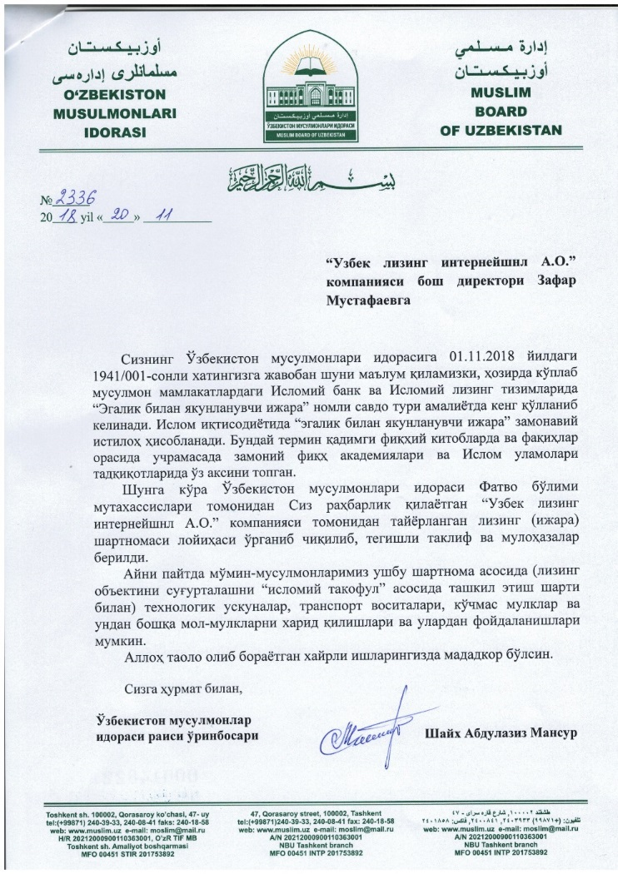
Existing Pipeline
Since 1995
On 20th of November, 2018 Uzbek Leasing International received a permission (Fatwa) from Muslim board of Uzbekistan to finance Ijarah using Takaful insurance.
In 2021, Uzbek Leasing International financed
8 projects for the amount more than USD 4 mln.
under the terms of Islamic leasing, which is 18%
of overall approved projects in 2021.

Slide 15
Lines of financing provided by ICD
Since 1995
Received:
Under implementation:
1st line of financing, 2008:
total amount: USD 1.0 million
2nd line of financing, 2014:
total amount: USD 5.0 million
3rd line of financing, 2017:
total amount: USD 7.0 million
Received in total: USD 13.0 mln
Projects financed: 36
New jobs created: more than 1000
4th line of financing, 2021
(at the stage of approval):
total amount: USD 10.0 million
Agreement on advisory service by ICD in the implementation of Islamic window in Uzbek Leasing International

Slide 16
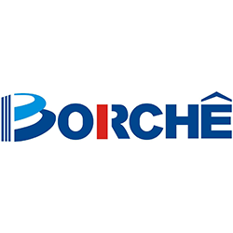
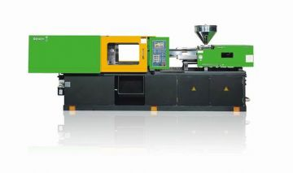
Samples of financed projects with ICD
Since 1995
Lessee | “ZANGIOTA-PLAST” (Tashkent region)
Lease object | Plastic injection moulding machine: BT 480 V-I and BT 480 V-I
Country of origin | China
Amount | USD 145 000

Slide 17
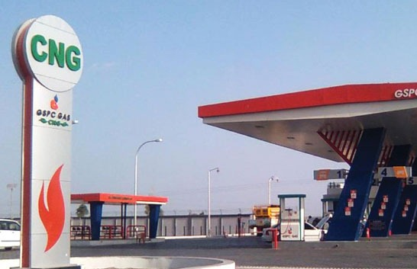
Samples of financed projects with ICD
Since 1995
Lessee | “TAIJOU INOVATOR” (Andijan region)
Lease object | 2 compressors for CNG filling station
Country of origin | KWANGSHIN MACHINE INDUSTRY CO., LTD South Korea
Amount | USD 600,000

Slide 18
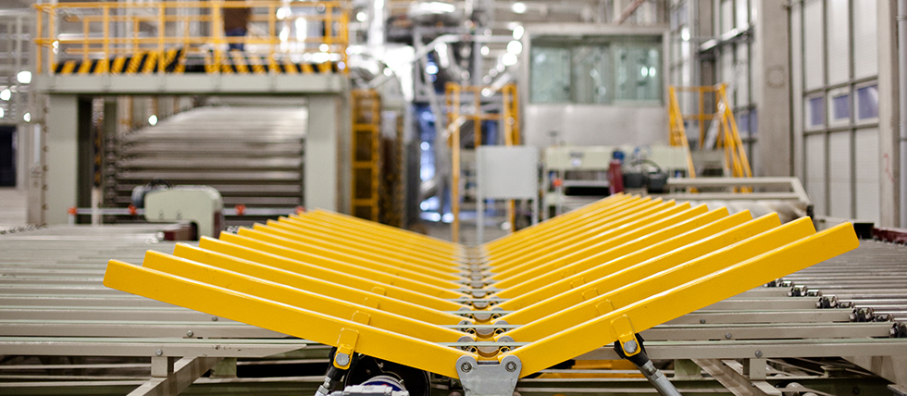
Samples of financed projects with ICD
Since 1995
Lessee | “NAVOIY-ULGURJI SAVDO” (Navoi region)
Lease object | Gypsum boards production line
Country of origin | China
Amount | USD 519 000

Slide 19
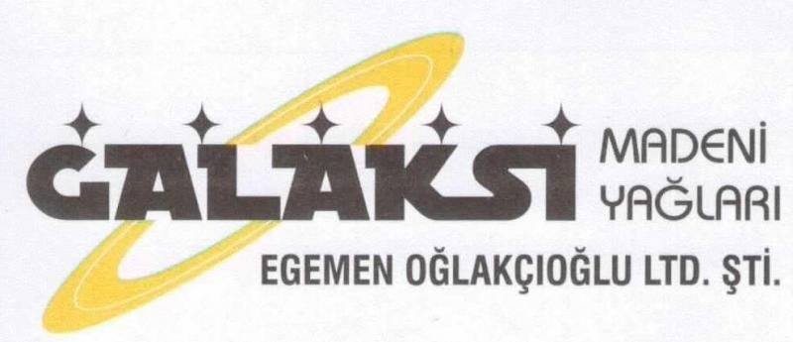
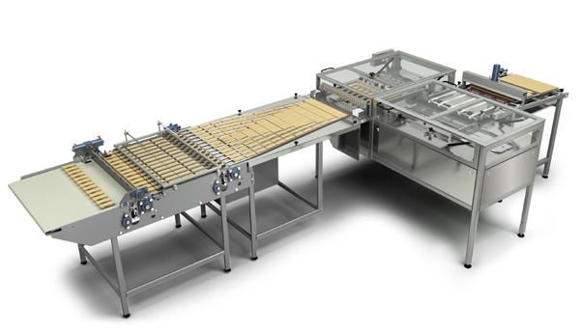
Samples of financed projects with ICD
Since 1995
Lessee | “YOSH FUTBOLCHI” (Tashkent city)
Lease object | Wafer production line
Country of origin | GALAKSI MAKINA VE AMBALAJ SAN.TIC.LTD.STI. Turkey
Amount | USD 596,000

Slide 20
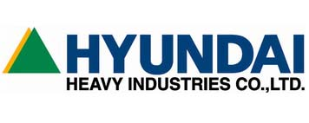
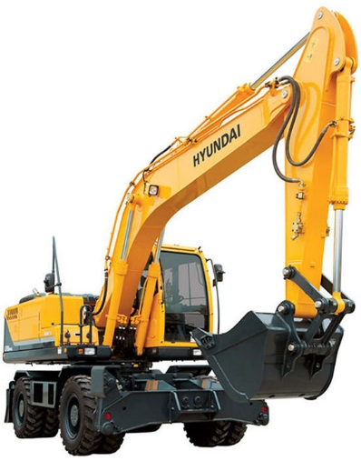
Samples of financed projects with ICD
Since 1995
Lessee | “Gijduvon Zarangari Qurilish” (Bukhara region)
Lease object | Wheeled excavator "HYUNDAI ROBEX 180W-9S" with hydrosystem and adaptor for hydrohummer
Country of origin | South Korea
Amount | USD 487,500

Slide 21
Opportunities in Uzbekistan
Islamic legislation in Uzbekistan is still in process, however, financial institutions offer their services, for instance: - Banks – Islamic window - Leasing companies – Murabaha, Ijarah - Retailer companies (e.g. Technomart, MediaPark) – Hire purchase
With the entry of foreign players, the microfinance services market has began to grow rapidly.
There is great potential for a Retailer companies with a focus on Islamic finance.

Slide 22
Thanks for your attention!

